Slide 1
Cell communication and cell signaling
Bacteria
GSM
Tutorial BB101 IIT Bombay

Slide 2
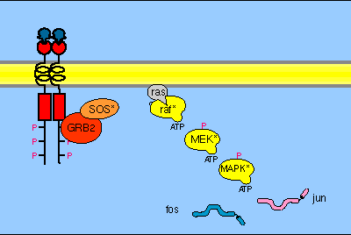
Receptor tyrosine kinases (RTKs)
Receptor tyrosine kinases (RTKs) are the high-affinity cell surface receptors for many polypeptide growth factors, cytokines, and hormones
1
Inactive monomers which act as
ligand
2
Ligand binds to the receptor and dimerization of the RTKs and stimulation of kinase activity
3
Auto-phosphorylation of RTKs
4
Docking of intra-cellular proteins to phosphor-tyrosine sites
5
Signal cascade to respond towards
bound ligand
https://signaltransductionpathway.weebly.com/tyrosine-kinase.html
Tutorial BB101 IIT Bombay

Slide 3
Receptor tyrosine kinases (RTKs)
Insulin, a hormone secreted by the pancreas to promote glucose utilization. At the molecular level, a cell senses insulin through insulin receptors (RTKs)and reduces the blood glucose.
What will happen if hormone binding domain of RTK gets mutated and restrain from sending signals?
Tutorial BB101 IIT Bombay
Notes:
Type-2 Diabetes

Slide 4
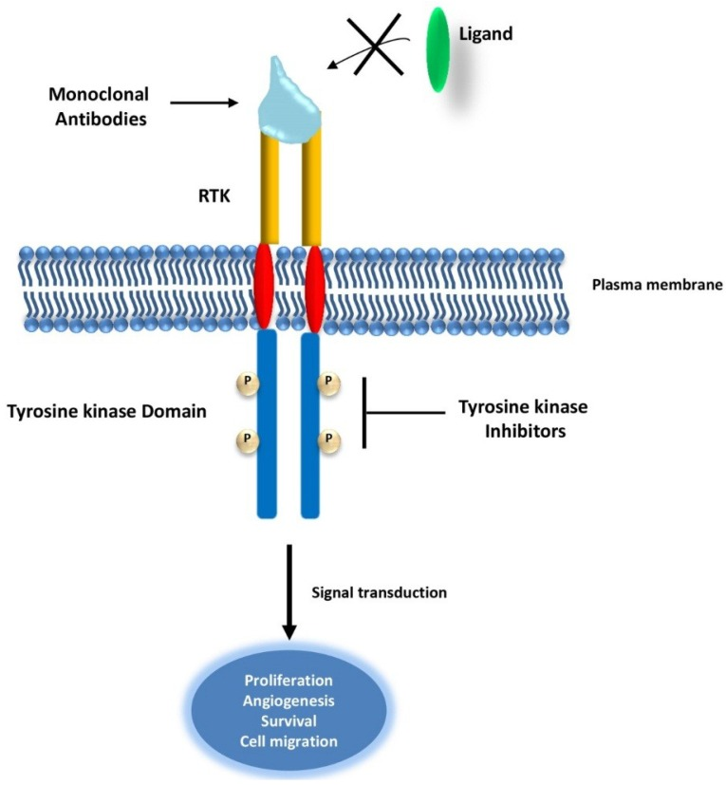
Targeting RTK Signaling Pathways in Cancer
In cancer therapy, RTKs are targeted using monoclonal antibodies that prevent ligand binding and therefore the activation of downstream signaling pathways. Tyrosine kinase inhibitors act on the tyrosine kinase domain of RTK, preventing receptors’ auto-phosphorylation and inhibiting signal transduction.
Tutorial BB101 IIT Bombay

Slide 5
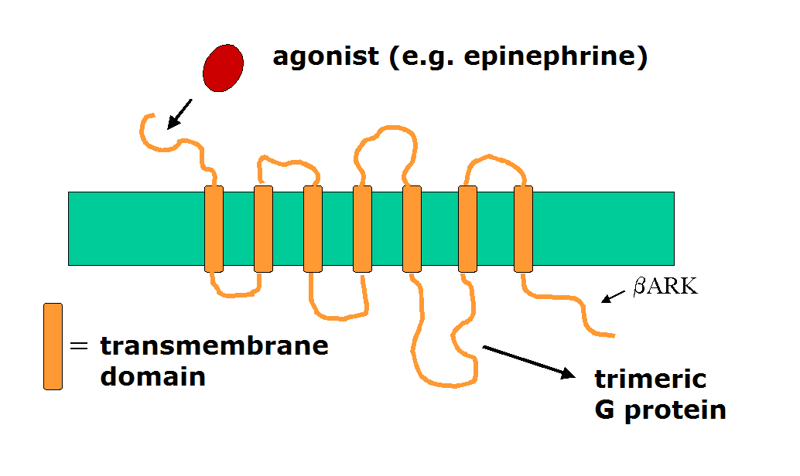
GPCRs
Signaling molecule (ligand) binds to GPCR on the outside
Binding induces change of shape (conformation)
Change of shape leads to binding of G-protein on the inside
Binding leads to exchange of GDP with GTP
GTP binding activates the G protein
Activated GPCR activates a series of downstream proteins to relay the information
Tutorial BB101 IIT Bombay

Slide 6
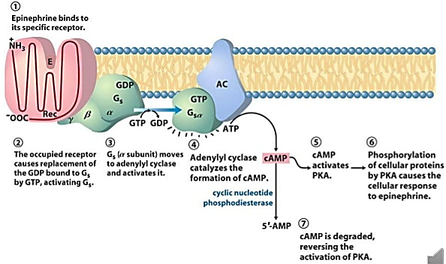
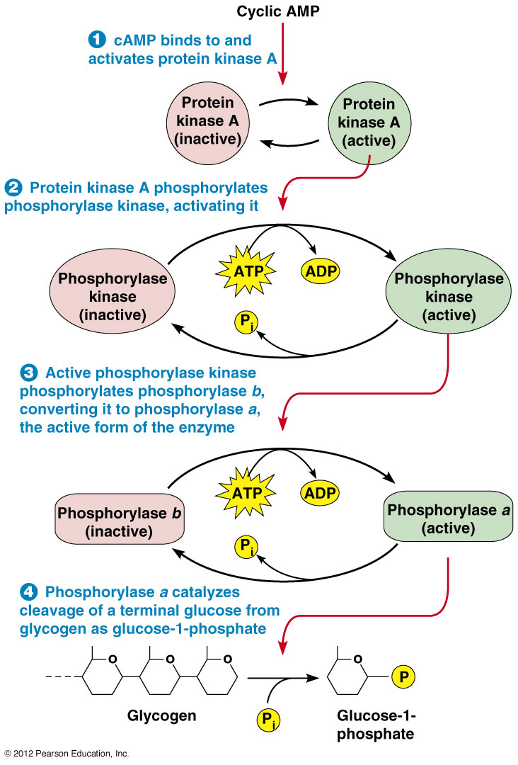
Epinephrine signaling pathway
Epinephrine also known as adrenalin or adrenaline, is a hormone and neurotransmitter.
It plays an important role in the fight-or-flight response by increasing blood flow to muscles, output of the heart, pupil dilation, and blood sugar.
7
Energy
8
Tutorial BB101 IIT Bombay

Slide 7
Bacteria

Slide 8
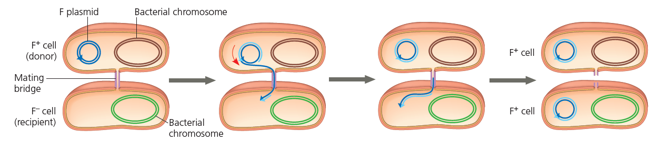
Conjugation
A process of DNA transfer between two prokaryotic cells by means of a physical interaction called the conjugation bridge.
Pilus from a donor cell attaches to another cell, it retracts pulling the two cells together, a temporary mating bridge is formed and the DNA then passes through this bridge.
Donor cell has F (fertility) factor which allows it to undergo conjugation.
Tutorial BB101 IIT Bombay

Slide 9
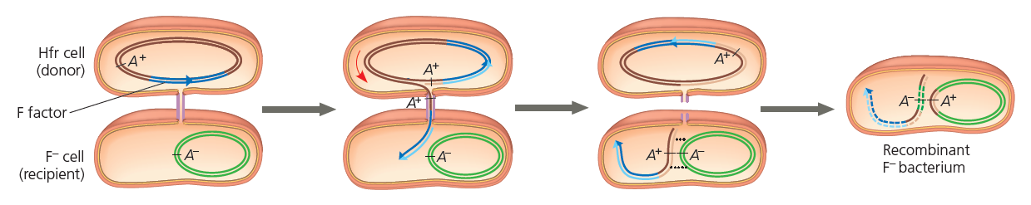
Conjugation
HFr cell – Bacterial cell that contains a portion of the F plasmid within its chromosome.
Homologous regions between HFr and F- chromosome may be exchanged producing a recombinant bacteria.
R plasmids – Confer antibiotic resistance. Natural selection causes bacteria containing R plasmids to survive in presence of antibiotic pressure.
Tutorial BB101 IIT Bombay

Slide 10
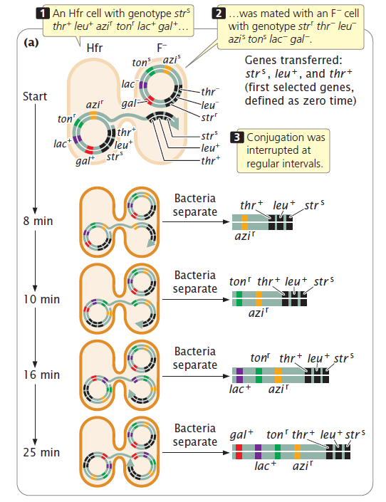
How can interrupted conjugation be used to map bacterial genes?
Tutorial BB101 IIT Bombay

Slide 11
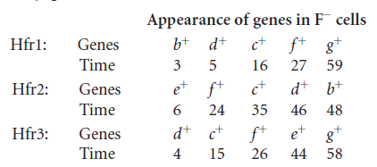
Problems on Conjugation
Crosses of 3 different Hfr strains with separate samples of an F- strain are carried out, and the following mapping data are provided from the studies of interrupted conjugation:
Construct a genetic map and the distances between them.
Tutorial BB101 IIT Bombay

Slide 12
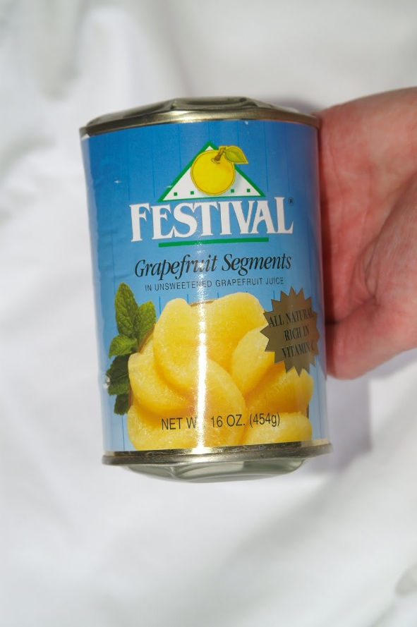
Food-borne diseases…
Scenario: You and your friend went for a field trip. After coming back, both of you suffered from a vomiting and stomach upset. You figured out that this was happened due to contaminated food. Your friend argued that, since the food was boiled properly , there are less chances of having contamination in the food.
How boiled food can be responsible for a stomach upset?
Tutorial BB101 IIT Bombay

Slide 13
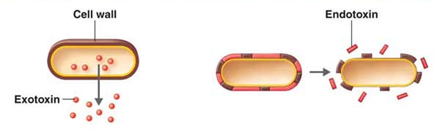
Bacterial toxins
Endotoxin
• Heat stable to 250ºC
• Part of outer membrane of gram
negative bacteria.
• Found in only gram negative bacteria;
released on bacterial death and some
liberated during growth.
Exotoxin
• Heat sensitive and inactivated at 60-
80ºC
• Excreted outside the living cell
• Produced by both gram positive and
gram negative bacteria.
Tutorial BB101 IIT Bombay

